Slide 1
Database Users
3

Slide 2
Today’s Agenda
Database users and users interfaces
Database Users
DBA
DA

Slide 3
Database users and users interfaces
A primary goal of a database system is to store the data and retrieve the particular data from the database whenever needed. People who work with a database can be categorized as database users.
The users of database system can be classified in the following groups depending on their degree of expertise or the mode of their interaction with the DBMS,

Slide 4
Database users
End Users
End users are those who access the database from the terminal end. They use the developed applications and they don’t have any knowledge about the design and working of database. These are the second class of users and their main motto is just to get their task done. There are basically three types of end users
Casual User
These users have great knowledge of query language. Casual users access data by entering different queries from the terminal end. They do not write programs but they can interact with the system by writing queries.
Naive
Sophisticated users

Slide 5
Database users
Naive users: Users who interact with the system by invoking one of the application program that have been written previously are called naïve users.
Sophisticated users: Users interact with the system without wring programs. They generate their request in the form of query. They form their request in a database query language.
Application programmers: Professionals programmers fall in this category. They are responsible for developing application program. The application program could be written in a general purpose programming language such as PASCAL, COBOL, C, C++, Java, etc. The programming languages include control structures and iterative statements.

Slide 6
Database users
Online users: There are users who may communicate with the database directly via an online terminal are called online users.
Specialized users: Users who are responsible to write specialized data application that do not fit into the conventional data processing system.

Slide 7
Database administrator (DBA)
The DBA is a special user who is created when the system is installed. The identity of the DBA is not same as the ordinary user.
The DBA is a person who provides the necessary technical support for implementing the decisions taken by administrator. The role of the DBA is relatively technical.

Slide 8
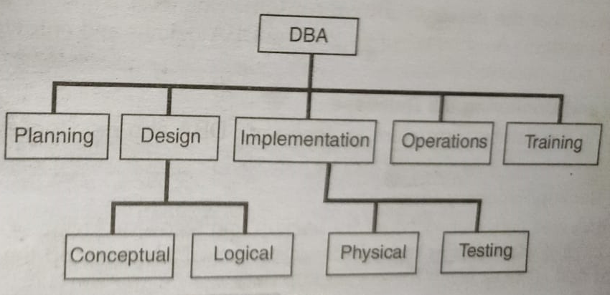
DBA Tasks

Slide 9
Function of DBA
Defining the schema
Installing and Upgrading
User Interaction
Storage Structure and Access Method Definition
Defining Integrity Constraints
Defining Security
Granting of Authorization for Data Access
Modifying and Monitoring the Database
Defining backup/ Recovery procedure
Monitoring Performance
Selection of Hardware and Software
Routine maintenance

Slide 10
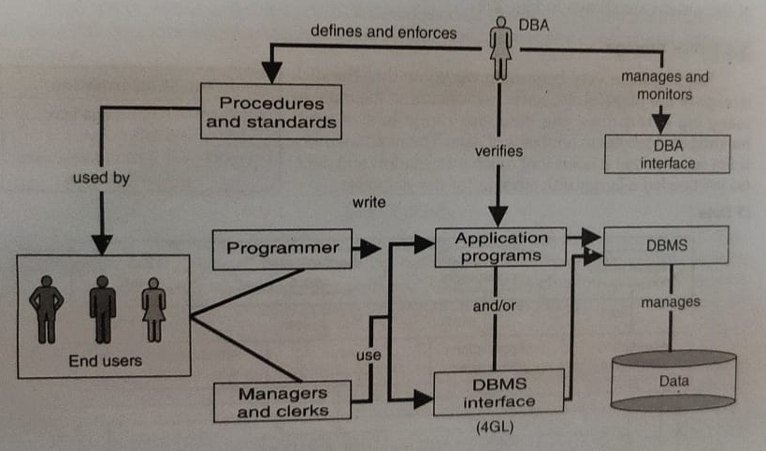
DBA

Slide 11
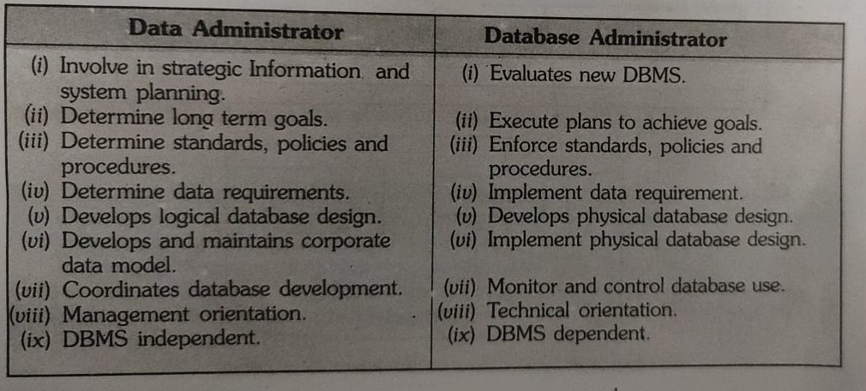
Data administrator
The data administrator (DA) is a person who makes the strategy and policy decisions regarding the data of the enterprise. DA determine long term goals, standards, policies and procedures which are implemented by DBA.

Slide 12


